Slide 1
Unit-II
The Central Processing Unit

Slide 2
Syllabus Contents
Arithmetic & Logic Unit.
Instruction Sets: - Machine Instruction Characteristics, Types of Operands and Types of Operations,
Addressing Modes, Instruction Formats, Instruction Types
Processor Structure and Function - Processor Organization, Register Organization, The Instruction Cycle and Instruction Pipelining.
RISC: Instruction Execution Characteristics, RISC Vs CISC, RISC Architecture - MIPS.

Slide 3
Arithmetic & Logic Unit
Does the calculations
Everything else in the computer is there to service this unit
Handles integers
May handle floating point (real) numbers
May be separate FPU (maths co-processor)
May be on chip separate FPU (486DX +)
Notes:
<number>

Slide 4
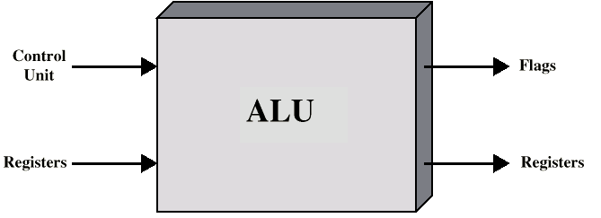
ALU Inputs and Outputs
Notes:
<number>

Slide 5
What is an instruction set?
The complete collection of instructions that are understood by a CPU
Machine Code
Binary
Usually represented by assembly codes
Notes:
2

Slide 6
Elements of an Instruction
Operation code (Op code)
Do this
Source Operand reference
To this
Result Operand reference
Put the answer here
Next Instruction Reference
When you have done that, do this...
Notes:
3

Slide 7
Operand Location
Source and result operands can be in one of four areas:
Main or virtual memory: As with next instruction references, the main or virtual memory address must be supplied.
Processor register: With rare exceptions, a processor contains one or more registers that may be referenced by machine instructions.
Immediate: The value of the operand is contained in a field in the instruction being executed.
I/O device: The instruction must specify the I/O module and device for the operation. If memory-mapped I/O is used, this is just another main or virtual memory address.

Slide 8
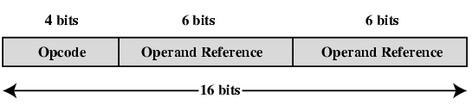
Simple Instruction Format

Slide 9
Types of Operand
Machine instructions operate on data. The most important general categories of data are:
Addresses
Numbers: Integer/floating point, Binary/Decimal
Characters: ASCII, EBCDIC etc.
Logical Data: Bits or flags
Notes:
14

Slide 10
Types of Operation
Data Transfer
Arithmetic
Logical
Conversion
I/O
System Control
Transfer of Control
Notes:
18

Slide 11
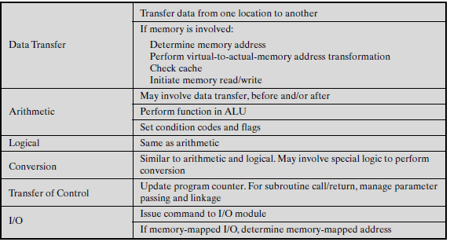
Processor Actions for Various Types of Operations

Slide 12
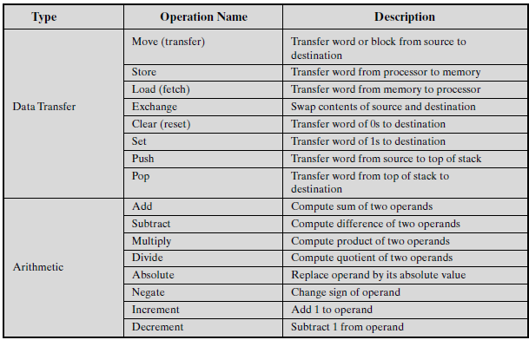
Common Instruction Set Operations

Slide 13
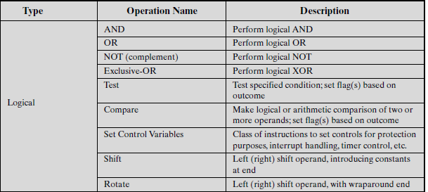
Common Instruction Set Operations (cont..)

Slide 14






Logical: Shift and Rotate Operations

Slide 15
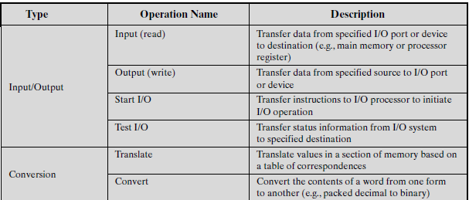
Common Instruction Set Operations (cont..)

Slide 16
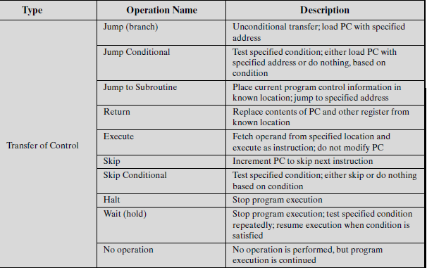
Common Instruction Set Operations (cont..)

Slide 17
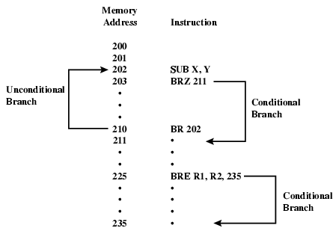
Transfer of Control: Branch Instruction

Slide 18
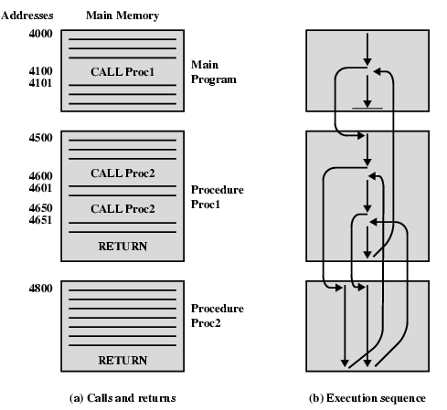
Transfer of Control: Nested Procedure Calls

Slide 19
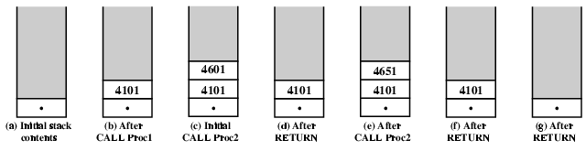
Transfer of Control: Use of Stack

Slide 20
Addressing
The address field or fields in a typical instruction format are relatively small.
To refer a large range of locations in main memory or, for some systems, virtual memory, a variety of addressing techniques has been employed.
They all involve some trade-off between :
Address range and/or addressing flexibility and
the number of memory references in the instruction and/or the complexity of address calculation

Slide 21
Addressing Modes
Immediate
Direct
Indirect
Register
Register Indirect
Displacement (Indexed)
Stack
Notes:
2

Slide 22
1. Immediate Addressing
Operand is part of instruction
Operand = address field
e.g. ADD 5
Add 5 to contents of accumulator
5 is operand
No memory reference to fetch data
Fast
Limited range
Instruction
Opcode
Operand
Notes:
3

Slide 23
2. Direct Addressing
Address field contains address of operand
Effective address (EA) = address field (A)
e.g. ADD A
Add contents of cell A to accumulator
Look in memory at address A for operand
Single memory reference to access data
No additional calculations to work out effective address
Limited address space
Notes:
5

Slide 24
Direct Addressing Diagram
Instruction
Opcode
Address A
Memory
Operand
Notes:
6

Slide 25
3. Indirect Addressing
Memory cell pointed to by address field contains the address of (pointer to) the operand
EA = (A)
Look in A, find address (A) and look there for operand
e.g. ADD (A)
Add contents of cell pointed to by contents of A to accumulator
Notes:
7

Slide 26
Indirect Addressing (cont..)
Large address space: 2^{n where n = word length}
the length of the address field in instruction is usually less than the word length, thus limiting the address range.
One solution is to have the address field refer to the address of a word in memory, which in turn contains a full-length address of the operand.
May be nested, multilevel, cascaded
^{e.g. EA = (((A)))}
Multiple memory accesses to find operand
^{Hence slower}
Notes:
8

Slide 27
Indirect Addressing Diagram
Instruction
Opcode
Address A
Memory
Pointer to operand
Operand
Notes:
9

Slide 28
4. Register Addressing
Operand is held in register named in address filed
EA = R
Limited number of registers
Typically, an address field that references registers will have from 3 to 5 bits
Hence a total of from 8 to 32 general-purpose registers can be referenced
Very small address field needed
Shorter instructions
Faster instruction fetch
Requires efficient usage
the operand in a register remains in use for multiple operations, then a real savings is achieved.
Notes:
10

Slide 29
Register Addressing (cont..)
No memory access
Very fast execution
Very limited address space
Multiple registers helps performance
Requires good assembly programming or compiler writing
Similar to Direct addressing
only difference is that the address field refers to a register rather than a main memory address
Notes:
11

Slide 30
Register Addressing Diagram
Instruction
Opcode
Register Address R
Registers
Operand
Notes:
12

Slide 31
5. Register Indirect Addressing
Operand is in memory cell pointed to by contents of register R
EA = (R)
Large address space (2^{n)}
One fewer memory access than indirect addressing
^{Similar to indirect addressing}
only difference is that the address field refers to a register rather than a main memory address
Advantages and limitations of register indirect addressing are similar to indirect addressing
Notes:
13

Slide 32
Register Indirect Addressing Diagram
Instruction
Opcode
Register Address R
Memory
Registers
Pointer to Operand
Operand
Notes:
14

Slide 33
6. Displacement Addressing
Address field hold two values
A = base value
R = register that holds displacement
or vice versa
EA = A + (R)
Very powerful mode of addressing
combines the capabilities of direct addressing and register indirect addressing
Notes:
15

Slide 34
Displacement Addressing Diagram
Instruction
Opcode
Register R
Address A
Memory
Registers
Pointer to Operand
+
Operand
Notes:
16

Slide 35
Displacement Addressing (cont..)
Most common uses of displacement addressing:
Relative addressing/ PC-Relative Addressing
Base-register addressing
Indexing

Slide 36
Relative Addressing
A version of displacement addressing
R = Program counter, PC
EA = A + (PC)
The next instruction address is added to the address field to produce the EA
Relative addressing exploits the concept of locality.
[Locality of reference: This principle states that memory references tend to cluster.]
If most memory references are relatively near to the instruction being executed, then the use of relative addressing saves address bits in the instruction.
Notes:
17

Slide 37
Base-Register Addressing
A -holds displacement
R -holds pointer to base (main memory)address
R may be explicit or implicit
e.g. segment registers in 80x86
Notes:
18

Slide 38
Indexed Addressing
A -holds base(main memory) address
R -holds displacement
EA = A + R
Good for performing iterative operations, accessing arrays
EA = A + R
R++
Notes:
19

Slide 39
Combinations
Postindex
EA = (A) + (R)
Preindex
EA = (A+(R))
(Draw the diagrams)
Notes:
20

Slide 40
7. Stack
LIFO property
So EA= top of the stack
No memory reference
Limited applicability

Slide 41
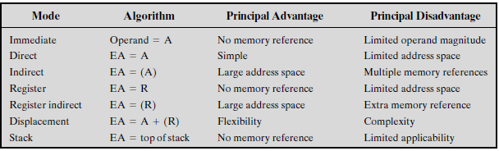
Summary of Basic Addressing Modes

Slide 42
Instruction Formats
Layout of bits in an instruction
Includes opcode
Includes (implicit or explicit) operand(s)
Usually more than one instruction format in an instruction set

Slide 43
Instruction Length
Affected by and affects:
Memory size
Memory organization
Bus structure
CPU complexity
CPU speed
Trade off between powerful instruction repertoire and saving space

Slide 44
Allocation of Bits
Number of addressing modes
Number of operands
Register versus memory
Number of register sets
Address range
Address granularity

Slide 45
Instruction Types
Data Processing: Arithmetic and logic instructions
Data storage (main memory): Movement of data into or out of register and or memory locations
Data movement (I/O):I/O instructions
Control: Test and branch instructions (Program flow control)
Notes:
6

Slide 46
Number of Addresses
3 addresses
Operand 1, Operand 2, Result
a = b + c;
Not common
Needs very long words to hold everything
2 addresses
One address doubles as operand and result
a = a + b
Reduces length of instruction
Requires some extra work
Temporary storage to hold some results
Notes:
7

Slide 47
Number of Addresses (cont..)
1 address
Implicit second address
Usually a register (accumulator)
Common on early machines
Eg. AC=AC+b
0 (zero) address
All addresses implicit
Uses a stack
e.g. push a
push b
add
pop c
c = a + b
Notes:
9

Slide 48
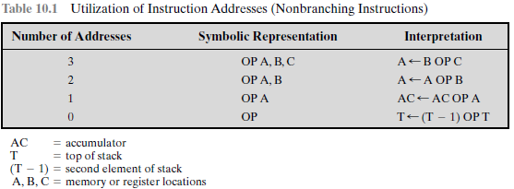
Number of Addresses (cont..)

Slide 49
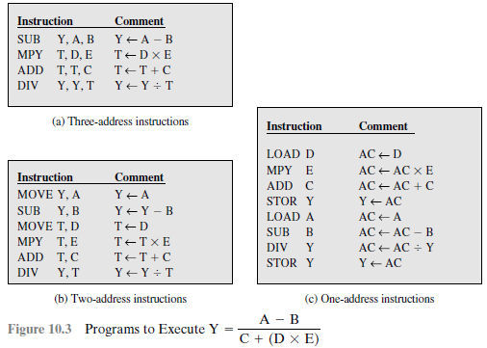
Example of different addresses

Slide 50
Processor Organization
CPU must:
Fetch instructions
Interpret instructions
Fetch data
Process data
Write data
A processor includes:
User-visible registers may be general purpose or have a special use, such as fixed-point or floating-point numbers, addresses, indexes, and segment pointers.
Control and status registers are used to control the operation of the processor. e.g. PC(program counter),PSW (program status word)

Slide 51
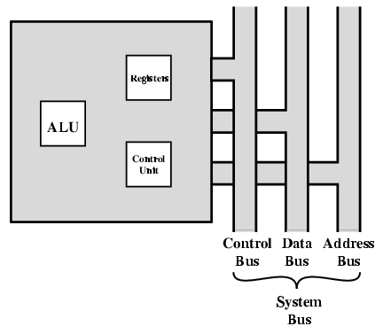
CPU With Systems Bus

Slide 52
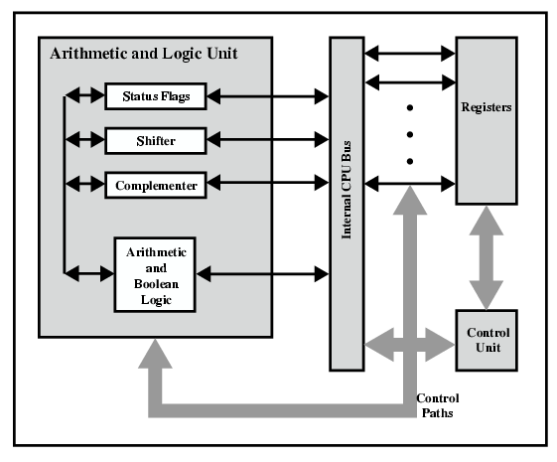
CPU Internal Structure

Slide 53
Registers
CPU must have some working space (temporary storage) called registers.
Number and function vary between processor designs
User Visible Registers:
General Purpose
Data
Address
Condition Codes
Notes:
23

Slide 54
General Purpose Registers
May be true general purpose
May be restricted
May be used for data or addressing
Data (e.g. Accumulator)
Addressing (e.g. Segment)
Make them general purpose
Increase flexibility and programmer options
Increase instruction size & complexity
Make them specialized
Smaller (faster) instructions
Less flexibility
Notes:
25

Slide 55
How Many GP Registers?
Between 8 - 32
Fewer = more memory references
More does not reduce memory references and takes up processor real estate
How Big?
Large enough to hold full address
Large enough to hold full word
Often possible to combine two data registers
C programming
double int a;
long int a;
Notes:
27

Slide 56
Condition Code Registers
Sets of individual bits
e.g. result of last operation was zero
Can be read (implicitly) by programs
e.g. Jump if zero
Can not (usually) be set by programs
Notes:
29

Slide 57
Control & Status Registers
Program Counter
Instruction Decoding Register
Memory Address Register
Memory Buffer Register
Notes:
30

Slide 58
Program Status Word
A set of bits that includes Condition Codes:
Sign of last result
Zero
Carry
Equal
Overflow
Interrupt enable/disable
Supervisor Mode
Intel ring zero
Kernel mode
Allows privileged instructions to execute
Used by operating system
Not available to user programs
Notes:
31

Slide 59
Other Registers
May have registers pointing to:
Process control blocks (see O/S)
Interrupt Vectors (see O/S)
Note: CPU design and operating system design are closely linked
Notes:
33

Slide 60
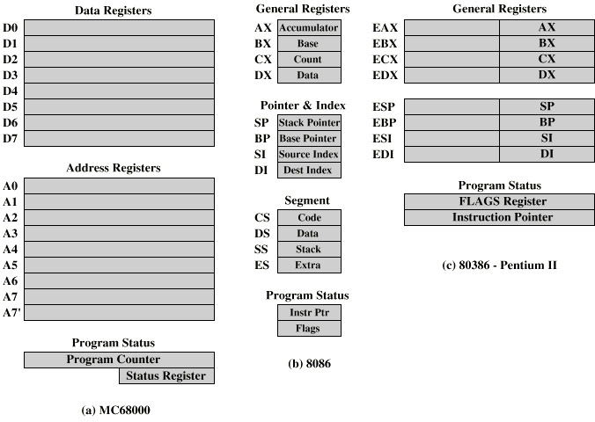
Example Register Organizations

Slide 61
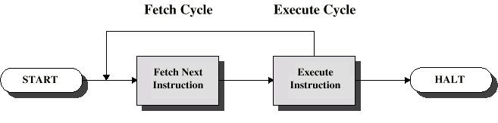
Instruction Cycle
Two steps:
Fetch
Execute
Notes:
<number>

Slide 62
Fetch Cycle
Program Counter (PC) holds address of next instruction to fetch
Processor fetches instruction from memory location pointed to by PC
Increment PC
Unless told otherwise
Instruction loaded into Instruction Register (IR)
Processor interprets instruction and performs required actions
Notes:
<number>

Slide 63
Execute Cycle
Processor-memory
data transfer between CPU and main memory
Processor I/O
Data transfer between CPU and I/O module
Data processing
Some arithmetic or logical operation on data
Control
Alteration of sequence of operations
e.g. jump
Combination of above
Notes:
<number>

Slide 64
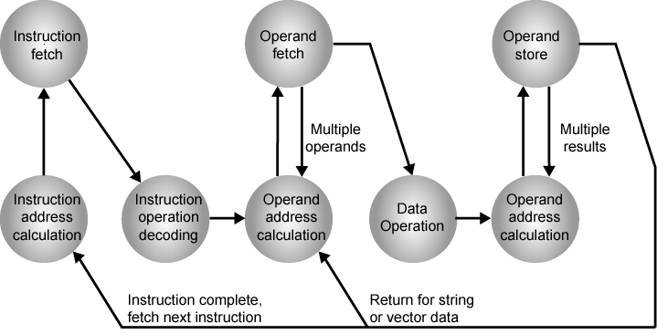
Instruction Cycle State Diagram
Notes:
<number>

Slide 65
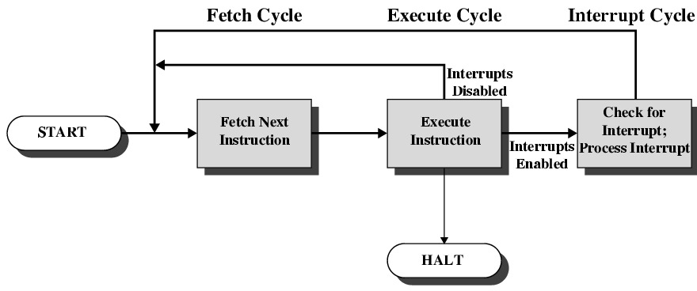
Instruction Cycle with Interrupts

Slide 66
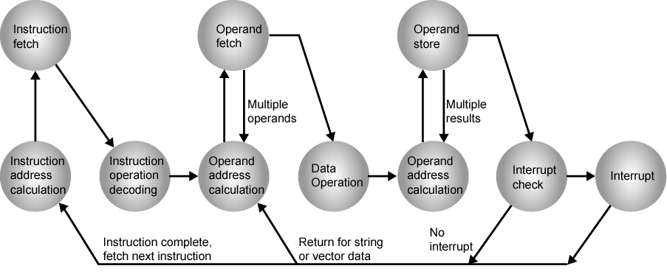
Instruction Cycle (with Interrupts) - State Diagram
Notes:
<number>

Slide 67
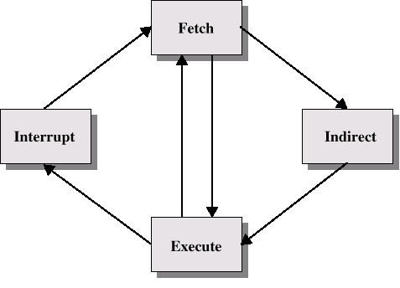
Indirect Cycle
May require memory access to fetch operands
Indirect addressing requires more memory accesses
Can be thought of as additional instruction subcycle
Instruction Cycle
with Indirect-

Slide 68
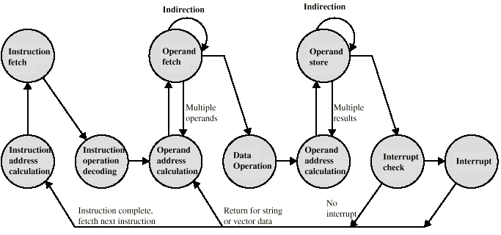
Instruction Cycle State Diagram

Slide 69
Data Flow (Fetch)
Depends on CPU design
Instruction Fetch
PC contains address of next instruction
Address moved to MAR
Address placed on address bus
Control unit requests memory read
Result placed on data bus, copied to MBR, then to IR
Meanwhile PC incremented by 1
Data Fetch
IR is examined
If indirect addressing, indirect cycle is performed
Right most N bits of MBR transferred to MAR
Control unit requests memory read
Result (address of operand) moved to MBR

Slide 70
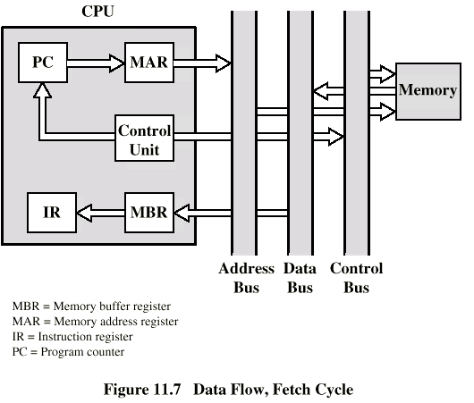
Data Flow (Fetch Diagram)

Slide 71
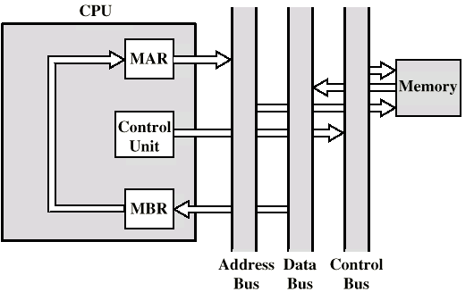
Data Flow (Indirect Diagram)

Slide 72
Data Flow (Execute)
May take many forms
Depends on instruction being executed
May include
Memory read/write
Input/Output
Register transfers
ALU operations

Slide 73
Data Flow (Interrupt)
Simple
Predictable
Current PC saved to allow resumption after interrupt
Contents of PC copied to MBR
Special memory location (e.g. stack pointer) loaded to MAR
MBR written to memory
PC loaded with address of interrupt handling routine
Next instruction (first of interrupt handler) can be fetched

Slide 74
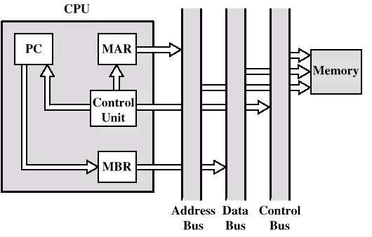
Data Flow (Interrupt Diagram)

Slide 75
Prefetch
Fetch accessing main memory
Execution usually does not access main memory
Can fetch next instruction during execution of current instruction
Called instruction prefetch
Notes:
36

Slide 76
Improved Performance
But not doubled:
Fetch usually shorter than execution
Prefetch more than one instruction?
Any jump or branch means that prefetched instructions are not the required instructions
Add more stages to improve performance
Notes:
37

Slide 77
Pipelining
Fetch instruction
Decode instruction
Calculate operands (i.e. EAs)
Fetch operands
Execute instructions
Write result
Overlap these operations
Notes:
38

Slide 78
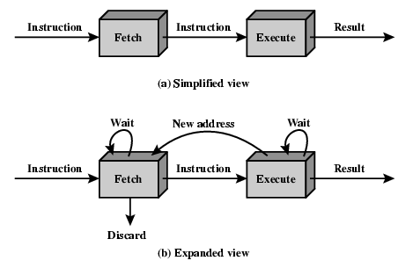
Two Stage Instruction Pipeline

Slide 79
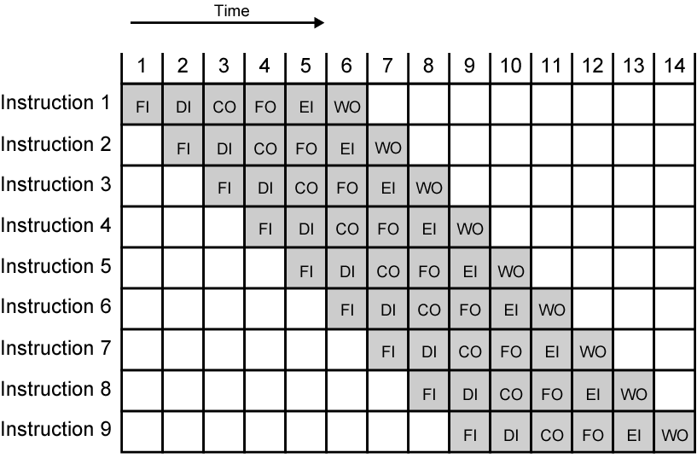
Timing Diagram for Instruction Pipeline Operation
Notes:
39

Slide 80
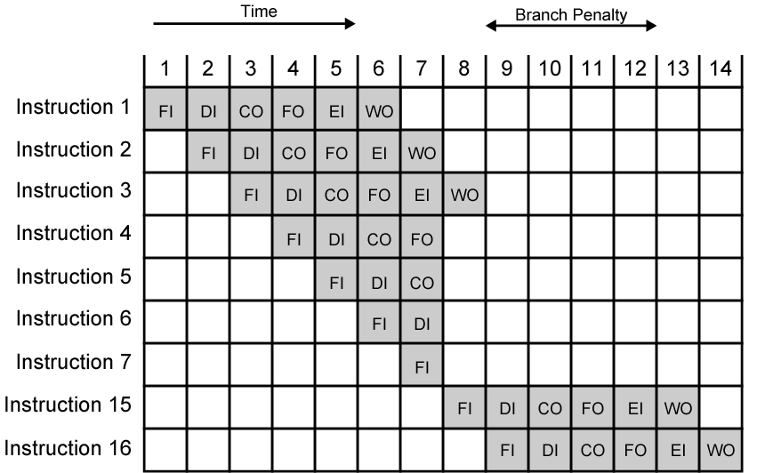
The Effect of a Conditional Branch on Instruction Pipeline Operation
Notes:
40

Slide 81
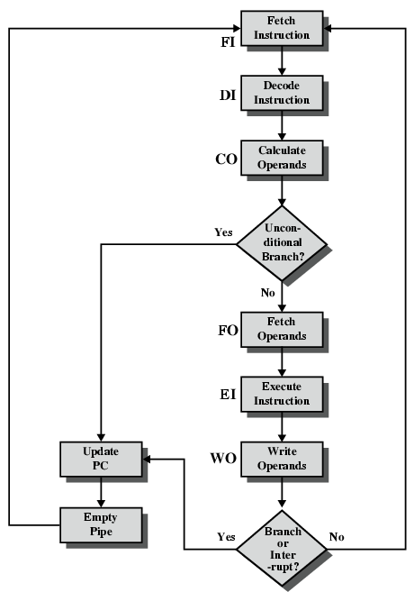
Six Stage Instruction Pipeline

Slide 82
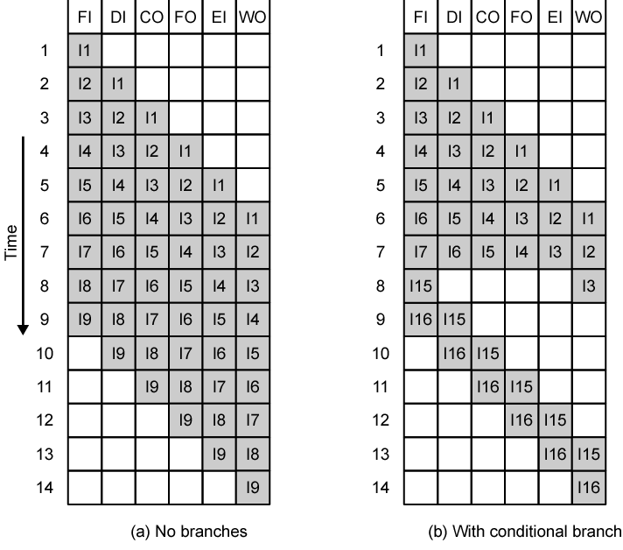
Alternative Pipeline Depiction

Slide 83
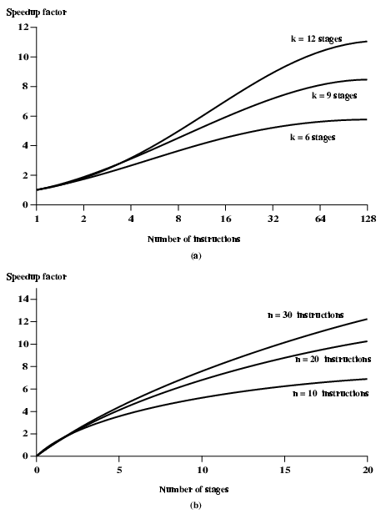
Speedup Factors with Instruction Pipelining

Slide 84
Instruction Execution Characteristics
Operations performed
These determine the functions to be performed by the processor and its interaction with memory.
Operands used
The types of operands and the frequency of their use determine the memory organization for storing them and the addressing modes for accessing them.
Execution sequencing
This determines the control and pipeline organization.
Studies have been done based on programs written in HLLs (High Level Languages)
Dynamic studies are measured during the execution of the program
Notes:
<number>

Slide 85
Operations
Assignments
Movement of data
Conditional statements (IF, LOOP)
Sequence control
Procedure call-return is very time consuming
Some HLL instruction lead to many machine code operations
Notes:
<number>

Slide 86
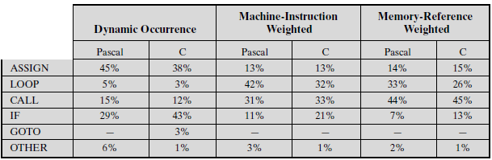
Weighted Relative Dynamic Frequency of HLL Operations [PATT82a]

Slide 87
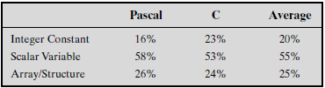
Operands
Mainly local scalar variables
Optimisation should concentrate on accessing local variables
Dynamic Percentage of Operands
Notes:
<number>

Slide 88
Procedure Calls
Very time consuming
Depends on number of parameters passed
Depends on level of nesting
Most programs do not do a lot of calls followed by lots of returns
Most variables are local
Notes:
<number>

Slide 89
Implications
Best support is given by optimising most used and most time consuming features
Large number of registers
Operand referencing
Careful design of pipelines
Branch prediction etc.
Simplified (reduced) instruction set
Notes:
<number>

Slide 90
Driving force for CISC (Complex Instruction Set computer)
Software costs far exceed hardware costs
Increasingly complex high level languages
Semantic gap: the difference between the operations provided in HLLs and those provided in computer architecture
Leads to:
Large instruction sets
More addressing modes
Hardware implementations of HLL statements
e.g. CASE (switch) on VAX
Notes:
<number>

Slide 91
Intention of CISC
Ease compiler writing
Improve execution efficiency
Complex operations in microcode
Support more complex HLLs
Notes:
<number>

Slide 92
CISC
Complex Instruction Set Computer
Large number of complex instructions
Low level
Facilitate the extensive manipulation of low-level computational elements and events such as memory, binary arithmetic, and addressing.
Examples of CISC processors are the
System/360(excluding the 'scientific' Model 44),
VAX,
PDP-11,
Motorola 68000 family
Intel x86 architecture based processors.
Notes:
<number>

Slide 93
CISC- Pro’s
Emphasis on hardware
Includes multi-clock complex instructions
Memory-to-memory:
"LOAD" and "STORE” incorporated in instructions
Small code sizes
high cycles per second
Transistors used for storing
complex instructions

Slide 94
CISC- Con’s
That is, the incorporation of older instruction sets into new generations of processors tended to force growing complexity.
Many specialized CISC instructions were not used frequently enough to justify their existence.
Because each CISC command must be translated by the processor into tens or even hundreds of lines of microcode, it tends to run slower than an equivalent series of simpler commands that do not require so much translation.
Notes:
<number>

Slide 95
RISC
Reduced Instruction Set Computer
Limited and simple instruction set
bans the indirect addressing mode
retains only those instructions that can be overlapped and made to execute in one machine cycle or less.
Large number of general purpose registers
or use of compiler technology to optimize register use
Emphasis on optimising the instruction pipeline
Notes:
<number>

Slide 96
RISC Examples
MIPS R4000, R3000, R2000
Apple iPods (custom ARM7TDMI SoC)
Apple iPhone (Samsung ARM1176JZF)
Palm and PocketPC PDAs and smartphones (Intel XScale family, Samsung SC32442 - ARM9)
Nintendo Game Boy Advance (ARM7)
Nintendo DS (ARM7, ARM9)
Sony Network Walkman (Sony in-house ARM based chip)
Some Nokia and Sony Ericsson mobile phones
Notes:
<number>

Slide 97
RISC- Pro’s
One instruction per cycle
Single-clock, reduced instruction only
Low cycles per second
large code sizes
Register to register operations
"LOAD" and "STORE“ are independent instructions
Spends more transistors on memory registers
Few, simple addressing modes
Few, simple instruction formats
Notes:
<number>

Slide 98
RISC- Pro’s (cont..)
Hardwired design (no microcode)
Fixed instruction format
More compile time/effort
Emphasis on software

Slide 99
RISC- Cons
By making the hardware simpler, RISC puts a greater burden on the software.
Software needs to become more complex.
Software developers need to write more lines for the same tasks.

Slide 100
RISC Vs CISC
Sr. No. | RISC | CISC
1 | Emphasis on software | Emphasis on hardware
2 | Single-clock, simple, reduced instructions | Includes multi-clock complex instructions
3 | Register to register: "LOAD" and "STORE" are independent instructions | Memory-to-memory: "LOAD" and "STORE" incorporated in instructions
4 | Few addressing schemes for memory operands with only two basic instructions, LOAD and STORE | Extensive addressing capabilities for memory operations.
5 | Low cycles per second, large code sizes | high cycles per second , small code sizes,

Slide 101
RISC Vs CISC
Sr. No. | RISC | CISC
7. | Many symmetric registers which are organized into a register file. | Relatively few registers.
8. | Hardwired control unit and machine instructions. | Microencoding of the machine instructions.
9. | Spends more transistors on memory registers | Transistors used for storing complex instructions
10. | e.g. MIPS R4000, R3000, R2000; Apple iPods (custom ARM7TDMI SoC); Apple iPhone (Samsung ARM1176JZF); ARM7,ARM9 etc. | e.g. System/360(excluding the 'scientific' Model 44),VAX, PDP-11, Motorola 68000 family, Intel x86 architecture based processors.

Slide 102
RISC Vs CISC
Not clear cut
Considerable controversy about which architecture is better.
Some experts say that RISC is cheaper and faster and therefore the architecture of the future.
Others note that RISC puts a greater burden on the software. Conventional CISC chips are becoming faster and cheaper anyway.
Many designs borrow from both philosophies
RISC and CISC architectures are becoming more and more alike. e.g. PowerPC and Pentium II
Notes:
<number>

Slide 103
RISC Vs CISC
Performances:
The CISC approach attempts to minimize the number of instructions per program, sacrificing the number of cycles per instruction.
RISC does the opposite, reducing the cycles per instruction at the cost of the number of instructions per program.

Slide 104
MIPS Architecture
MIPS – semiconductor company that built one of the first commercial RISC architectures
Why MIPS instead of Intel 80x86?
MIPS is simple, elegant. Don’t want to get bogged down in gritty details.
MIPS widely used in embedded apps, x86 little used in embedded, and more embedded computers than PCs
e.g. MIPS R2000,R3000,R4000

Slide 105
MIPS Instruction Set Architecture(ISA)
Designed for use with high-level programming languages
small set of instructions and addressing modes, easy for compilers
Minimize/balance amount of work (computation and data flow) per instruction
allows for parallel execution
Load-store machine
large register set, minimize main memory access
Fixed instruction width (32-bits), small set of uniform instruction encodings
minimize control complexity, allow for more registers

Slide 106
MIPS ISA (cont..)
All data operations are register to register;
the only memory references are pure load/store operations.
The R4000 makes no use of condition codes.
If an instruction generates a condition, the corresponding flags are stored in a general-purpose register.
This avoids the need for special logic to deal with condition codes as they affect the pipelining mechanism and the reordering of instructions by the compiler.
Instead, the mechanisms already implemented to deal with register-value dependencies are employed.

Slide 107
MIPS ISA (cont..)
MIPS instructions fall into 5 classes:
Arithmetic/logical/shift/comparison
Control instructions (branch and jump)
Load/store
Other (exception, register movement to/from GP registers, etc.)
Only the simplest and most frequently used memory-addressing mode is implemented in hardware.
All memory references consist of a 16-bit offset from a 32-bit register.
e.g.- the “load word” instruction is of the form
lw r2, 128(r3) /* load word at address 128 offset from
register 3 into register 2
Each of the 32 general-purpose registers can be used as the base register.
One register, r0, always contains 0.

Slide 108
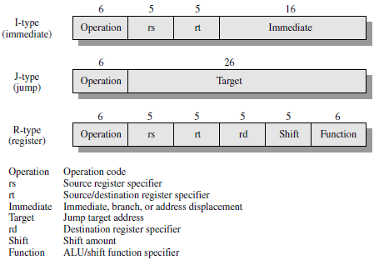
MIPS Instruction Formats

Slide 109
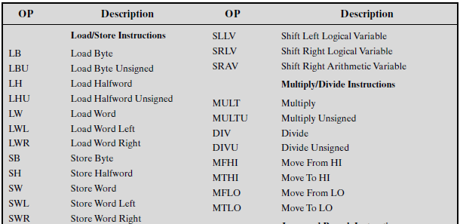
MIPS R series Instruction Set (1)

Slide 110
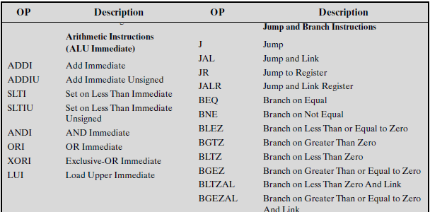
MIPS R series Instruction Set (2)

Slide 111
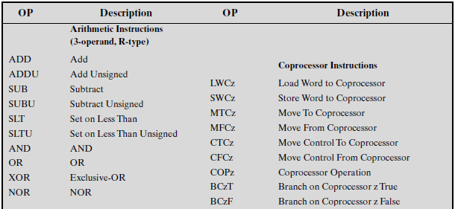
MIPS R series Instruction Set (3)

Slide 112
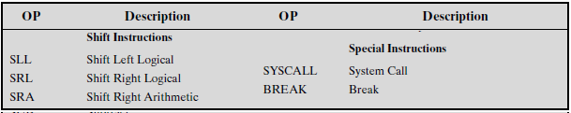
MIPS R series Instruction Set (4)

Slide 113
MIPS Instruction Example
Consider an assembly-language instruction that uses a 32-bit immediate argument
lw r2, #imm(r4) /* load word at address using a 32-bit immediate
offset #imm from register 4 into register 2
This can be compiled into the following MIPS instructions:
lui r1, #imm-hi /* load upper immediate for loading the upper
half of a register 1 with a 16-bit immediate
value #imm-hi, setting the lower half of r1 to
0. Where #imm-hi is the high-order 16 bits
of #imm
addu r1, r1, r4 /* add unsigned #imm-hi to r4 and put in r1
lw r2, #imm-lo(r1) /* load word at address using a 32-bit
immediate offset #imm-lo from register 1
into register 2 where #imm-lo is the low-
order 16 bits of #imm

Slide 114
MIPS Pipelining
A superscalar architecture replicates each of the pipeline stages so that two or more instructions at the same stage of the pipeline can be processed simultaneously.
A superpipelined architecture is one that makes use of more, and more fine-grained, pipeline stages. With more stages, more instructions can be in the pipeline at the same time, increasing parallelism.
Both approaches have limitations:
With superscalar pipelining, dependencies between instructions in different pipelines can slow down the system. Also, overhead logic is required to coordinate these dependencies.
With superpipelining, there is overhead associated with transferring instructions from one stage to the next.

Slide 115
MIPS Pipelining
In a superpipelined system, existing hardware is used several times per cycle by inserting pipeline registers to split up each pipe stage.
Essentially, each superpipeline stage operates at a multiple of the base clock frequency, the multiple depending on the degree of superpipelining.
The R4000 technology has the speed and density to permit superpipelining of degree 2.
a much larger and specialized adder was designed. This makes it possible to execute ALU operations at twice the rate.
Other improvements allow the execution of loads and stores at twice the rate.

Slide 116
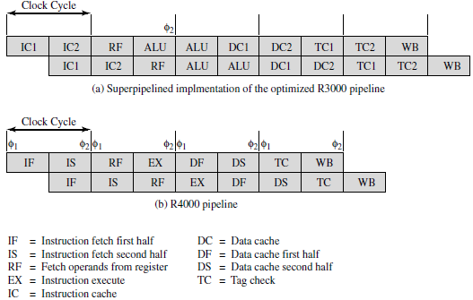
Theoretical R3000 and Actual R4000 Superpipelines

Slide 117
The Eight Pipeline Stages of R4000
Instruction fetch first half: Virtual address is presented to the instruction cache and the translation lookaside buffer.
Instruction fetch second half: Instruction cache outputs the instruction and the TLB generates the physical address.
Register file: Three activities occur in parallel:
Instruction is decoded and check made for interlock conditions (i.e., this instruction depends on the result of a preceding instruction).
Instruction cache tag check is made.
Operands are fetched from the register file.

Slide 118
The Eight Pipeline Stages of R4000 (cont..)
Instruction execute: One of three activities can occur:
If the instruction is a register-to-register operation, the ALU performs the arithmetic or logical operation.
If the instruction is a load or store, the data virtual address is calculated.
If the instruction is a branch, the branch target virtual address is calculated and branch conditions are checked.
Data cache first: Virtual address is presented to the data cache and TLB.
Data cache second: The TLB generates the physical address, and the data cache outputs the instruction.
Tag check: Cache tag checks are performed for loads and stores.
Write back: Instruction result is written back to register file.

